Slide 1
Welcome
Phonics in EYFS
Badbury Park Primary School

Slide 2
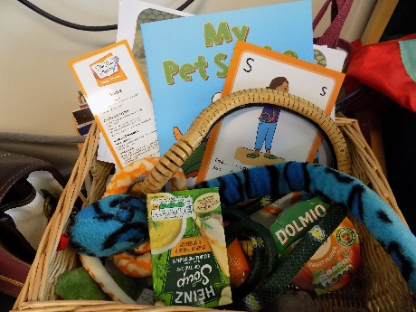
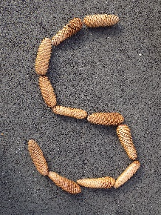
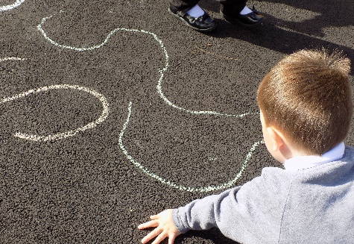
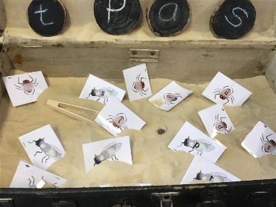
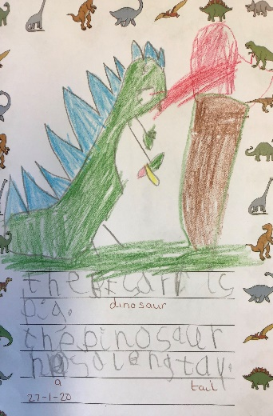
We follow the Twinkl phonics scheme and enrich it with the magic of the Phonic Fairy from Story Time phonics.
Phonics at Badbury Park, encourages children to develop a love of reading. All children will be introduced to new sounds through the discovery of a real book. Story Time Phonics also introduces the children to ‘tricky words’ through the ‘Tricky Troll’ character and children learn to read non-words (made up words) with Beegu- the alien.

Slide 3
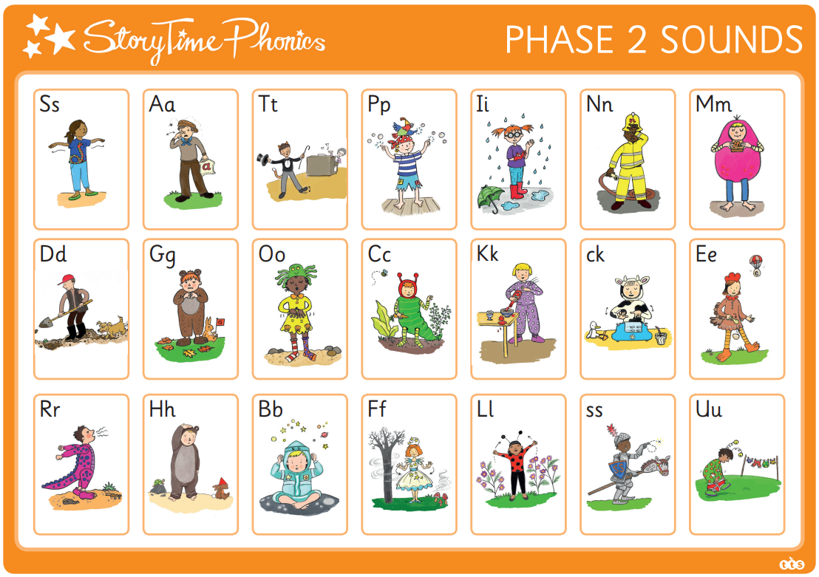
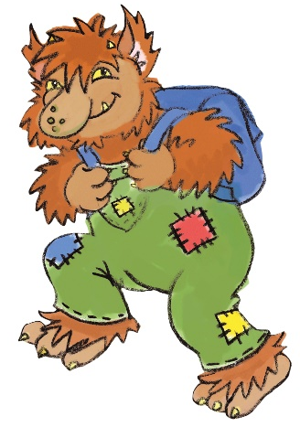
We teach phase 2,3 and 4 sounds and the ‘high frequency’ words that they make. ‘High frequency’ words are words the children are likely to see often in books.
We will teach Tricky Troll words.
These are words that can not be
decoded e.g. I, no, to, the

Slide 4
Support for blending
Using ‘pure’ sounds, helps the children to blend to read words.

Slide 5
Taken from The Book Trust’s booklet ‘Reading with your Child’
Available from here https://cdn.booktrust.org.uk/globalassets/resources/misc/reading-with-your-child/reading-with-your-child-booklet-for-parents.pdf

Slide 6
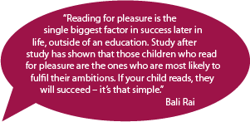
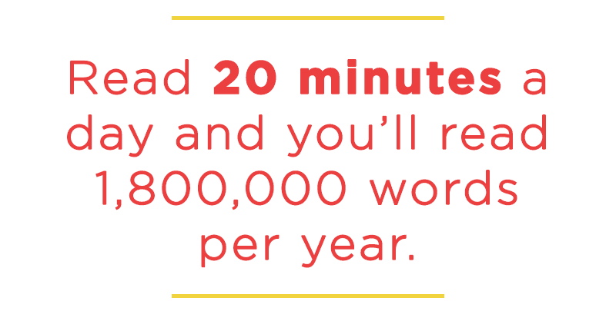
Reading

Slide 7
Reading
Individual reading
At school, we hear each child read individually at least once a week. Reading books and reading records need to be in school everyday. At home we ask you to ‘strive for five!’, this means that your child is aiming to read at home 5 times over the week- every day would be amazing!
Sharing stories and book talk
At school, we share books and stories at least twice a day. We ask that you try to share a book with your child each
day, a bedtime story would be ideal. You can also
talk about what happened and what their
favourite part was.

Slide 8
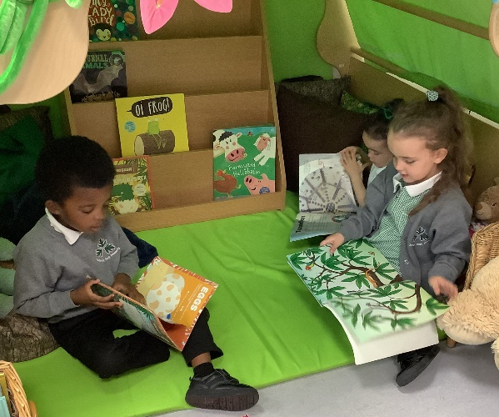
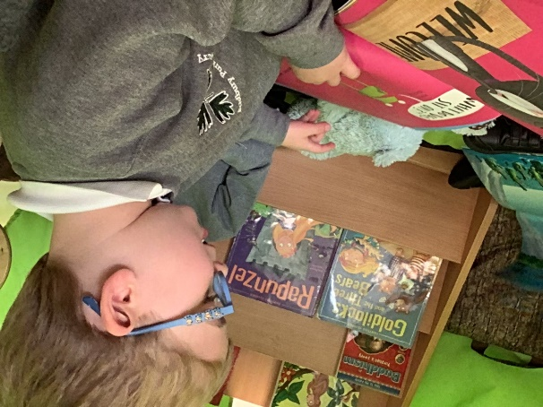
Before reading…
It might be helpful for you to let your child know that in a few minutes, it’ll be time for reading. They could use this opportunity to get wriggles out, use the toilet, finish a task etc. By doing this consistently each time, your child will start to anticipate and look forward to the time you have reading together.
Find somewhere quiet and cosy to sit.
Have everything you might need e.g. pen, reading record etc.

Slide 9
During reading…
Encourage the children to ‘sound out’ unknown decodable words e.g. C-a-t.
If they are struggling to ‘blend’ the sounds together to read the word, do it together… you can try segmenting 3 times and then blending. We do this in class too so the children will be familiar with it. You can also segment slowly, then a bit quicker and then really fast- this technique usually helps them to hear the whole word well. Though children usually find this one tricky to do themselves. If all else fails you can model good segmenting and blending and encourage them to join in and ‘have a go’
Encourage the children to remember ‘Tricky Troll’ words. These words have tricky bits in them, but there are some sounds that will be decodable too.
Lots of praise, keep it flowing and make it enjoyable!

Slide 10
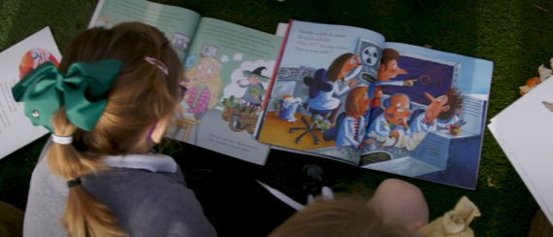
After reading…
Praise praise praise!
If your child is still focused, you can ask about their favourite part of the story or their favourite character. Be inquisitive- why was that part your favourite? Share your favourite part and why too. We call this ‘book talk!’
Tell your child how much you enjoyed hearing them read and how proud you are of their efforts.
Explain that you’re looking forward to the next session…hopefully this will be the next day!
Log the reading in their yellow reading record

Slide 11
Please ask us questions…
We would like all of our parents to know that we are always here and ready to support you, so please ask if you aren’t sure or something isn’t quite working. We are here to help!

Slide 12
Top tips…
For under-7’s, 5-10 minutes is usually enough. Little and often is best – strive for 5!
If it’s a new book, always start by having a look at the book’s cover, title, pictures and characters.
When your child tries to ‘sound out’ words, encourage the use of a phonetic letter sounds rather than ‘alphabet names’. So for ‘cat’ you would say c-a-t; not CAT.
Please don’t pressurise if he or she is reluctant. Remain positive and if your child loses interest, then do something else and come back to it at a better time.
Maintain the flow. If your child mispronounces a word, try not to interrupt immediately. Instead allow opportunity for self-correction. It is better to tell a child some unknowing words or give clues from the context/pictures to keep things moving rather than insisting on their trying to build them all up from the sounds of the letters.

Slide 13
Phonics fun at home!
Some websites and apps you could use at home to support your child with their phonics and letter formation:
Phonics Play
Topmarks Phonics
Twinkl – ‘free phonics’
Phonics Bloom
Teach Your Monster to Read
Cbeebies ABC Go Explore

Slide 14
*EXCITING NEW OPPORTUNITY*
Would you be interested in becoming a Badbury reading volunteer?
We aim to build a team of at least 4 reading volunteers to come into school and hear the children read. If you can commit to giving at least 30 mins/1 hour of your time per week, we would like to hear from you…
Please contact the school office and leave your name and contact details as soon as possible. We will be in
touch next week with more information!

Slide 15
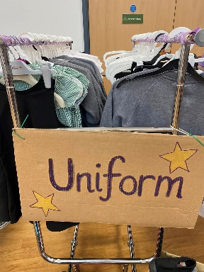
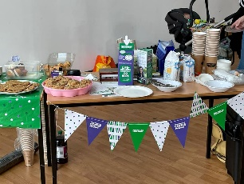
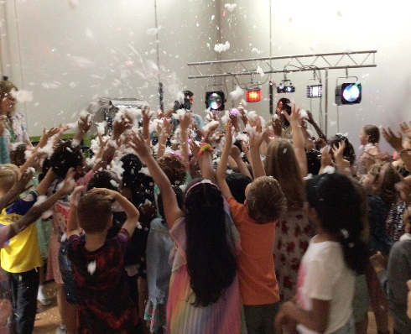
Friends of Badbury Park Primary
Who are we?
We are mostly made up of parents who volunteer to raise money to enable our school to pay for events, activities or equipment not covered by the normal school budget.
Who can join?
Anyone over 18 can join such as parent, carer, grandparent, teacher or staff member.
What do I need to do?
As a committee member you attend monthly meetings and have voting rights on events and funding
Alternatively you can be a volunteer who offers to help at events when asked
Things funded by PTA:
Summer Disco
Christmas Book From Santa
Easter Bookmarks
Storytime Mats
Events we have organised:
Christmas Fair
Bake Sales
Summer Fair
Fund Raisin Challenge
Preloved Uniform Sales
Pocket Money Stalls
Freezer Fridays
How to reach us:
Facebook – Friends of Badbury Park Primary School PTA
Friendsofbadburyparkprimary@gmail.com

Slide 16
AOB:
Interactive Learning Diary
If you have not received an email regarding ILD to sign up, or you are having problems with this platform, please let us know.
Reading record and books
Please sent them in to school everyday in a book bag or backpack.
Changing
Please work with your children to practice
taking jumpers/t-shirts on and off.
Water bottles
Please ensure your child has a named water bottle in school every day, and it is filled with water only.

Slide 17
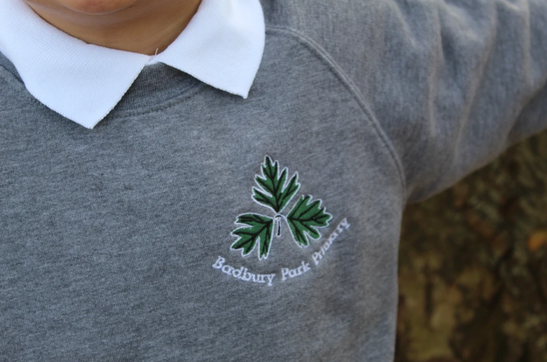
What uniform does your child need in Reception?
School uniform
PE kit:
- Green t-shirt
- Black joggers/shorts
- Daps/trainers
Water bottle (with only water)
Wellies and waterproofs
Bookbag or folder containing your
child’s reading book and record
Please let your child practice taking their uniform on and off by themselves and ensure their clothing is easy for them to take off/pull down.
Please name everything!

Slide 18
Safeguarding
We aim to promote wellbeing and maintain a safe, secure and caring environment where everyone is treated with respect.
If you have any concerns about a child please report it to Mrs L Dance, Mrs Christmas, Mrs Tkocz or Mr Hanks.

Slide 19
Thank you

