Slide 1
Welcome
Year 1
Badbury Park Primary School

Slide 2
Meet the Beech Tree Class Team
(Year 1)
Teacher
Mrs Moore
Teaching Assistant
Mrs Bell/ Mrs Casey

Slide 3
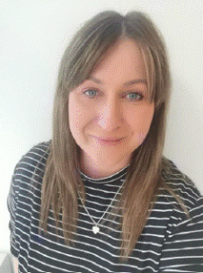
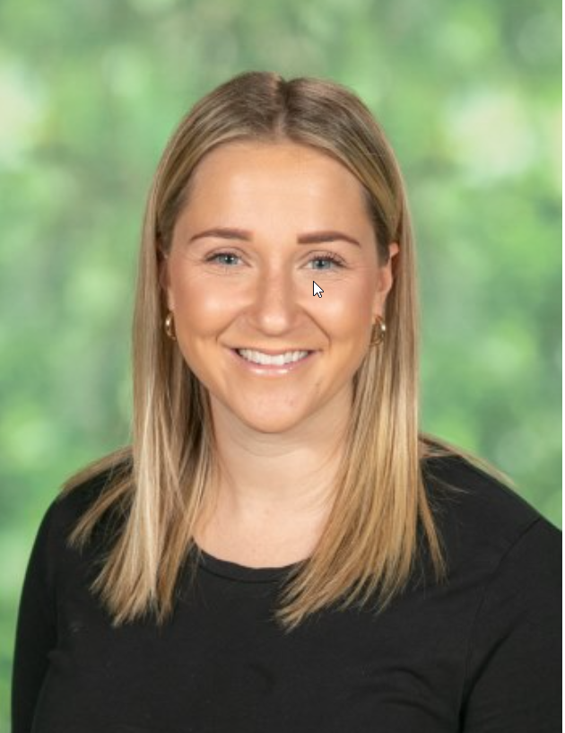
Meet the Pine Tree Class Team
(Year 1)
Teachers
Mrs Stutt
Mrs Magiera
Teaching Assistant
Miss Hatton

Slide 4
What uniform does your child need in Year 1?
School uniform:
- Grey school jumper/cardigan
- White polo t-shirt
Black trousers/skirt
Black shoes/trainers
Green check summer school uniform
PE kit:
-Green t-shirt
-Black joggers/shorts
-Daps/trainers
Please name everything!

Slide 5
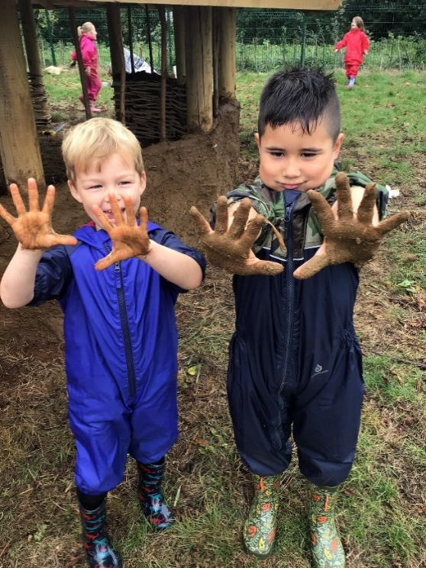
What else does your child need in Year 1?
Water bottle (with only water)
Wellies and waterproofs
Bookbag or folder containing your
child’s reading book and record (every day)
Spelling folder (every Friday)
Please name everything!

Slide 6
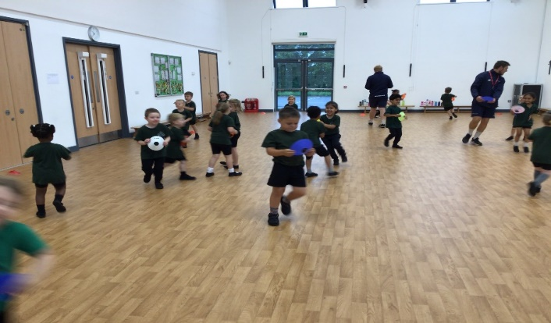
PE
At least 1 session a week
Please help to support your child’s independence by giving them opportunities to dress themselves at home- this will help with a quick change for PE in school.
All uniform will stay in school. PE kits will go home at the end of every term.
Please name everything!

Slide 7
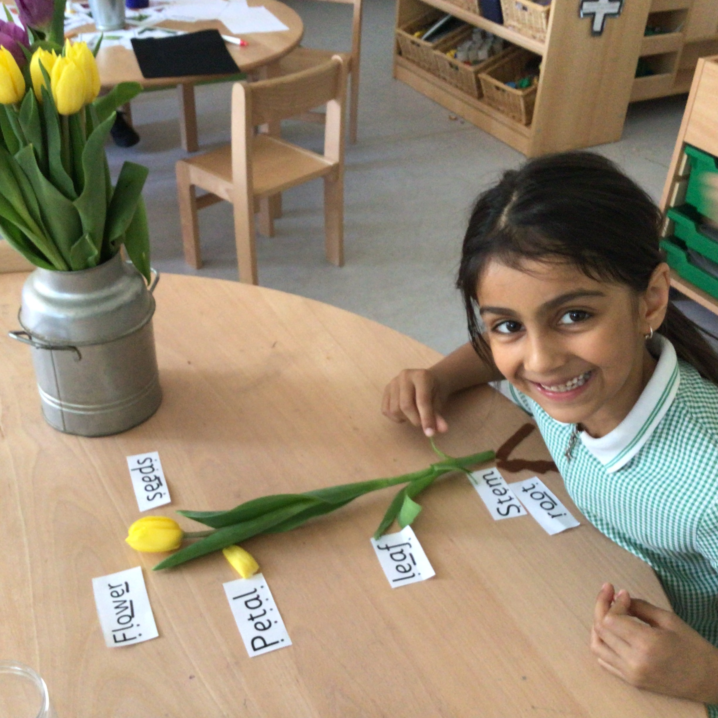
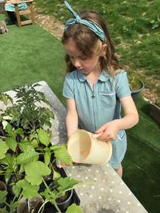
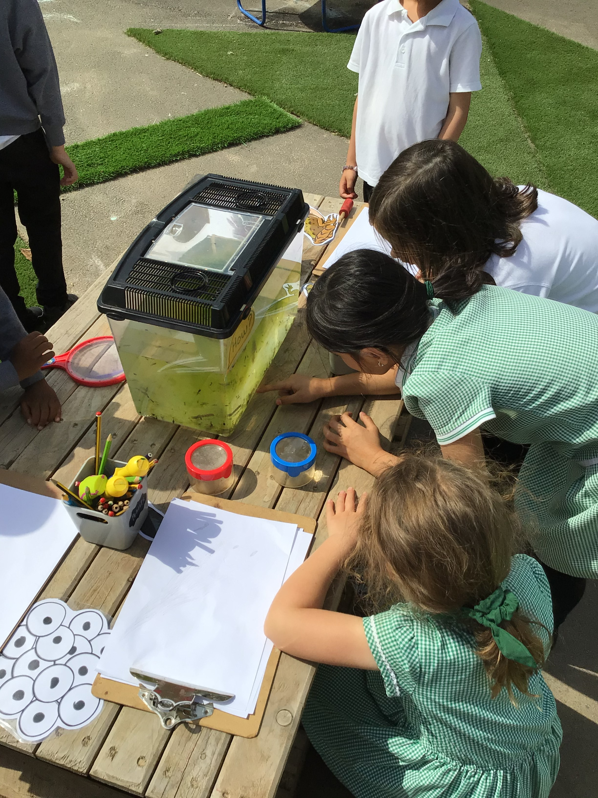
Our Vision
We want happy, engaged leaners within a beautiful, authentic learning space that is calm and consistent. We use natural, versatile, open ended resources that are carefully chosen to provoke creativity, wonder and concentration both inside and outside. We want an environment where children are confident to risk take and problem solve whilst learning both knowledge and skills and where the natural world takes center stage.
Nurturing and enrichment
We are aware that children will continue to need lots of nurture and wellbeing work and we have planned our curriculum around this. Interventions to help any children will be put in place once we get to know your children. Wellbeing and feeling safe and secure are our primary goals because without that, the learning won’t take place.

Slide 8
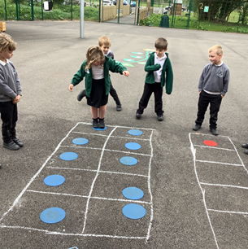
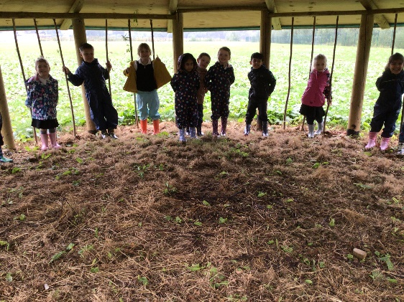
Our School Day
8.30-8.45 Classroom doors open- soft start
8:45-8.55 Funky fingers/register
8:55- Phonics
9.30- English
10:15-Break
10:30 Assembly
10.45-Explore and Learn (readers)
12.00-Lunch
1.00-Circle time
1.10-Maths
2.00- Foundation subject
3.00-Story
3.15- Home time

Slide 11
About Year 1…
Up until Christmas- the first term of Year 1- the children will make a gradual transition over to the National Curriculum. Children who didn’t meet all their Early Learning Goals will continue to explore these in preparation for the National Curriculum. There will be a continued focus on independent learning alongside whole class and small group teacher led sessions.
We will be following the Government’s framework to assess the children’s reading ability in the Phonic Screening Check. This check will take place in the summer term of Year 1.

Slide 12
Writing in Year 1
Children will be taking part in at least one focused handwriting lesson per week.
Children will say their words and sentences before writing them.
They will write in many genres e.g. stories, letters, diaries, fact files.
We will ask the children to tell us what they have written and to make edits to improve their writing.
We will be trying hard to form our letters correctly using the Storytime Phonics ‘Sparkle Mark’ sayings.
We will leave finger spaces in between words.
We will use a range of punctuation. Year 1- ! ? . CL (capital letter) Year 2– all of the above, plus , “ ‘.
We will use our phonics and Tricky Troll words to spell our words.

Slide 13
Reading in Year 1
The children will talk about the meanings of words and what is happening in the pictures of a story.
They will join in with poems and hear rhyme.
They will be predicting what might happen next in a story.
Children will explain clearly their understanding of what has been read.
They will retell the story after reading it or by looking at the pictures.
They will break words they hear into sounds to spell and blend them together to read (segment and blend).
They will learn new sounds when they are ready with Story Time Phonics and Twinkl Phonics (see website).
They will recognise many Tricky Troll words.
By the end of the year, children will have a love of books and read with fluency, being able to compare different types of books.

Slide 14
Maths in Year 1
By the end of the year children are expected to be able to:
· count to and across 100, forwards and backwards, beginning with 0 or 1, or from any given number
· count, read and write numbers to 100 in numerals; count in multiples of twos, fives and tens
· given a number, identify one more and one less
· identify and represent numbers using objects and pictorial representations including the number line, and use the language of: equal to, more than, less than (fewer), most, least
· read and write numbers from 1 to 20 in numerals and words.
Addition and Subtraction
· read, write and interpret mathematical statements involving addition (+), subtraction (–) and equals (=) signs
· represent and use number bonds and related subtraction facts within 20
· add and subtract one-digit and two-digit numbers to 20, including zero
· solve one-step problems that involve addition and subtraction, using concrete objects and pictorial representations, and missing number problems such as 7 = ? – 9

Slide 15
Continued…
Multiplication and Division
· solve one-step problems involving multiplication and division, by calculating the answer using concrete objects, pictorial representations and arrays with the support of the teacher
Fractions
· recognise, find and name a half as one of two equal parts
· recognise, find and name a quarter as one of four equal parts of an object, shape or quantity.
Measurement
Measure and begin to record the following:
· lengths and heights
· mass/weight
· capacity and volume
· time (hours, minutes, seconds to o’clock and half past)
Properties of Shape
Recognise and name common 2-D and 3-D shapes including:
· 2-D shapes [for example, rectangles (including squares), circles and triangles]
· 3-D shapes [for example, cuboids (including cubes), pyramids and spheres].
Position and Direction
· describe position, direction and movement, including whole, half, quarter and three quarter turns.

Slide 16
Example of ARE Reading.
Government guidance is that a child working at age related expectations should be reading green or orange books by the end of Year 1.
Reading at home is one of the best ways to support your child’s learning. At Badbury Park we strive for five.
An important skill is to re-read books. The first time we read to decode, the second time, we read for meaning.
Please look after books!

Slide 17
Spellings
Every Monday, the children will bring home a spelling sheet containing words that link to the phonics that will be taught in class during the week.
Please take the time to practise these with your child.
These words will not be formally tested but we are looking to see how the children apply these spellings in their writing.
We will also be sending home the year 1 tricky words.
The children will practise these regularly in school and we ask that you support this at home too. We aim for children to be able to read and write all of the Year 1 words by the end of the year.

Slide 18
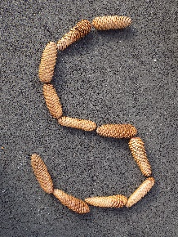
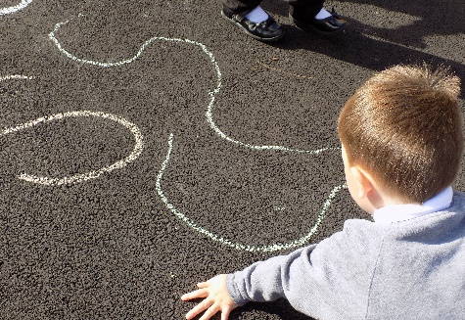
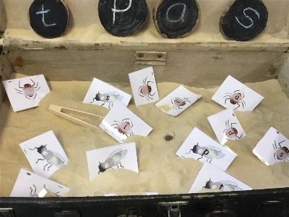
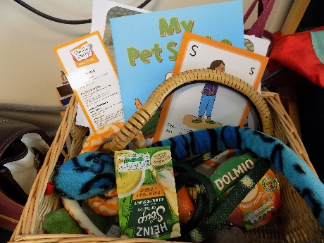
Phonics
We follow the Story Time Phonics scheme underpinned by Twinkl Phonics. In Year 1, we will rapidly move through recapping all of the sounds learned so far at the beginning of every phonics session and during small group work. Segmenting and blending will still be a focus so that children begin to do this rapidly and automatically to aid with fluent reading.
In phonics, we will be streaming so that those children who still need to revisit some sounds in more depth will have an opportunity to do so during their phonics lesson.

Slide 19
The National Curriculum
We provide a broad and balanced curriculum which includes teaching:
English- grammar, spellings (including phonics), handwriting, reading and writing
Maths
Science
Design Technology
Art
Music
RE
PE
PSHE
History and Geography

Slide 20
Outdoor Learning and Forest School
In Year 1, children will have ample opportunities for outdoor learning and will be having regular forest school sessions. Our outdoor learning will include cross curricular links with the following:
Education for social responsibility (ESR)
Science
Design Technology
Art
Geography
English
Maths

Slide 21
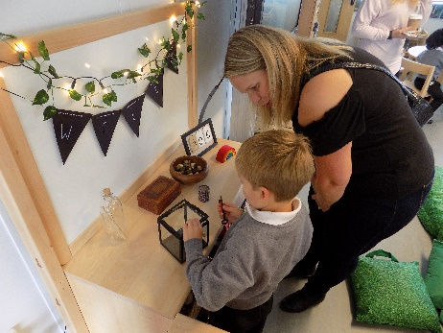
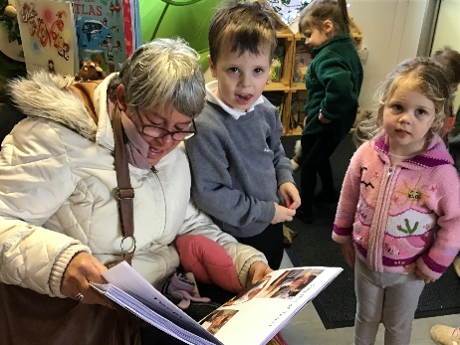
Assessments, parents evenings and learning journeys
Phonics Screening Check in the Summer Term
Parents evenings x2 and termly ‘book looks’
Termly report cards (PUCS)
End of year report assessed against the expectations for Year 1
We will also complete ongoing assessments to inform our planning. This may include things like live marking, show of whiteboards, questions and quizzes.

Slide 22
If things aren’t going so well…
Please do come and talk to us In the morning, on the door can be busy, but if it is urgent, please let us or the office know. You can make an appointment through the office. They have access to our diaries and also can pass a message on.
Please speak to your child’s class teacher first, as we work with your child everyday. If the class teacher is not available please speak to Mrs Debono as the KS1 lead.
If you continue to have concerns you can then, after speaking to the class teacher, speak to Mrs Debono, KS1 lead and assistant head or Mrs Christmas (assistant head for inclusion) and if you still do not feel that the matter is resolved, please speak to Mrs Dance. We have a formal complaints policy on our website.
Please email, telephone or tell us if there is anything we need to know about your child or any change of circumstances.

Slide 23
Other notices:
First aid:
We will notify you of a head injury or if we feel your child needs to be collected, as stated in our policy.
You will receive a message, if your child has been given first aid.

Slide 24
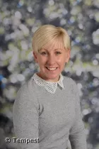
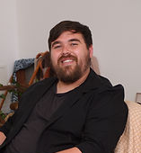
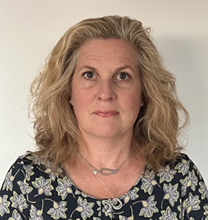
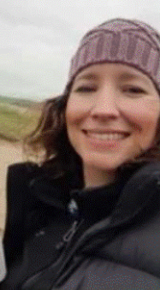
Safeguarding
We aim to promote wellbeing and maintain a safe, secure and caring environment where everyone is treated with respect.
If you have any concerns about a child please report it to Mrs L Dance as the designated safeguarding lead. You can also report your concerns to Mrs Christmas, Mr Hanks or Mrs Tkocz if Mrs Dance is not available.

